Slide 1
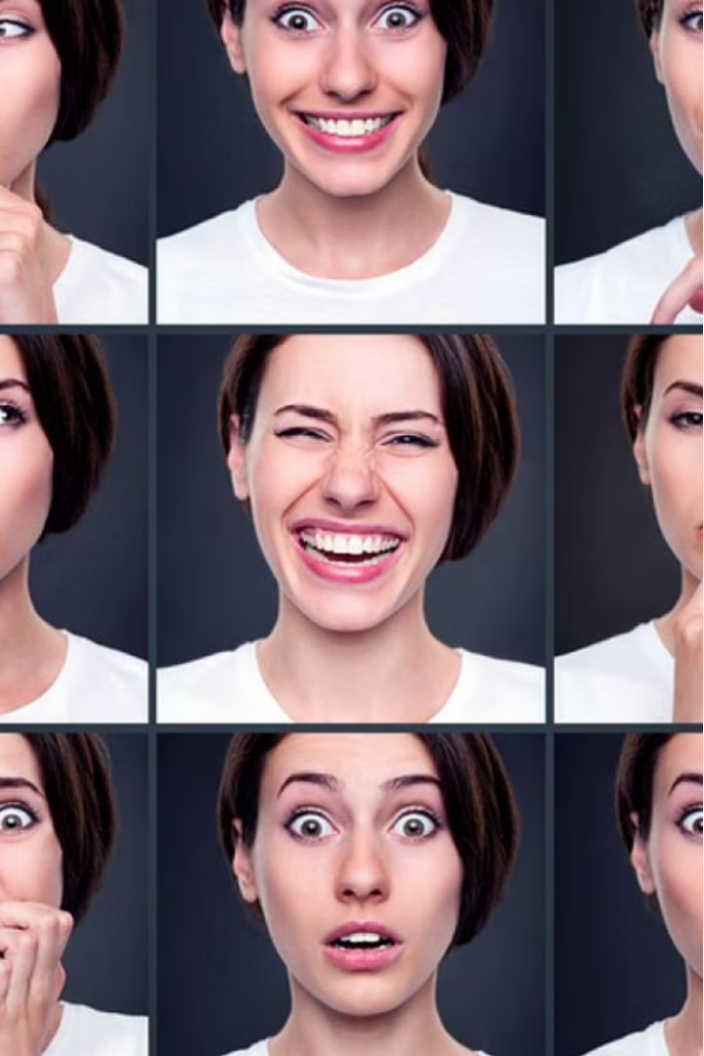
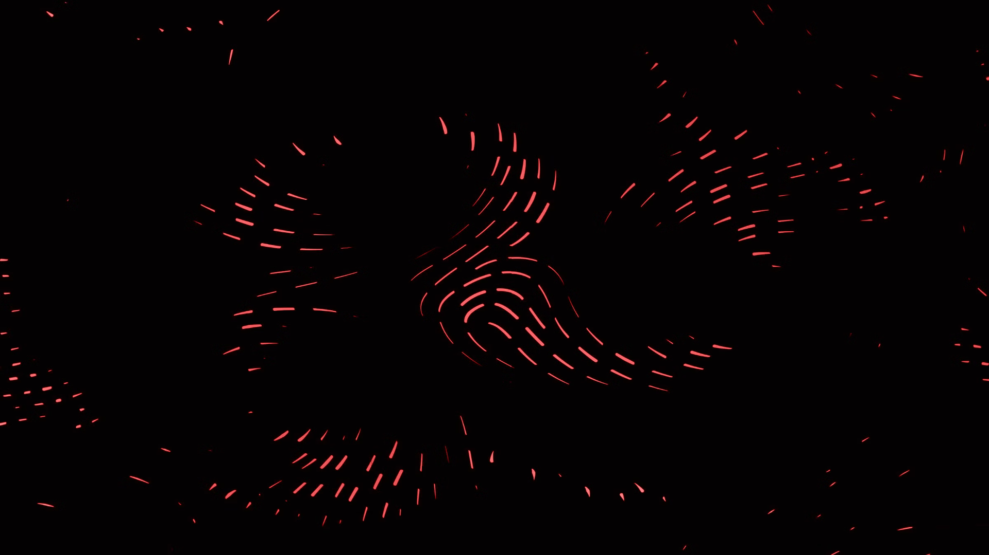

Introduction to Face Expression Recognition
Face emotion detection is a technology that uses artificial intelligence (AI) and computer vision to analyze facial expressions and infer the emotional state of a person

Slide 2
Data Acquisition:
The process starts with capturing an image or video stream containing a person's face. This can be done through webcams, security cameras, or smartphone cameras. 2. Preprocessing:
The captured image or video frames undergo preprocessing steps to prepare them for analysis. This may involve tasks like: Grayscale conversion (focusing on intensity variations instead of color) Face detection and alignment (locating the face and ensuring a consistent orientation for analysis) Normalization (adjusting for lighting variations and head pose)

Slide 3
Feature Extraction:
The preprocessed image is then analyzed to extract key facial features that are crucial for recognizing emotions. These features often include: Positions of facial landmarks (eyes, eyebrows, mouth, nose) Distances and angles between these landmarks Wrinkles and furrows on the forehead and around the eyes 4. Classification:
Extracted features are fed into a machine learning model, typically a deep neural network (DNN), trained to recognize emotions. The DNN has been trained on a massive dataset of labeled facial expressions, where each image or video is associated with a specific emotion (e.g., happiness, sadness, anger, surprise). During classification, the DNN analyzes the features and predicts the most likely emotion based on the patterns it has learned from the training data. 5. Output:
The final output of the system is the predicted emotion for the person in the image or video frame. This can be a single emotion label (e.g., "happy") or a probability distribution for different emotions (e.g., 70% happy, 20% neutral, 10% surprised).

Slide 4
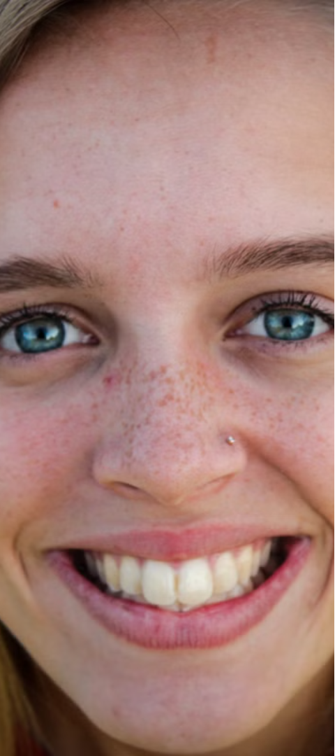
The Importance of Facial Expressions
1
Emotional Intelligence
2
Enhanced Interactions
Facial expressions are a crucial aspect of nonverbal communication, providing valuable insights into an individual's emotional state and social cues.
By understanding facial expressions, we can build more empathetic and natural interactions, improving everything from customer service to human-robot collaboration.
3
Psychological Research
Analyzing facial expressions can yield important data for researchers studying human behavior, emotion, and mental health.

Slide 5
Techniques for Facial Expression Recognition
Computer Vision
Machine Learning
Multimodal Approaches
Leveraging advanced computer vision algorithms to detect and classify facial features and expressions.
Training neural networks and other ML models to accurately recognize and interpret facial expressions.
Combining facial analysis with other data sources, such as speech, body language, and contextual information.

Slide 6
Applications of Face Expression Recognition
Human-Computer Interaction
Mental Health Monitoring
Enabling more natural and intuitive interactions between humans and machines, such as in gaming, virtual assistants, and e-commerce.
Assisting in the diagnosis and treatment of mental health conditions by analyzing emotional patterns and behavioral cues.
Marketingand Advertising
Automotive Safety
Helping businesses better understand customer reactions and preferences to improve their products and services.
Monitoring driver alertness and emotional state to enhance safety and prevent accidents.

Slide 7
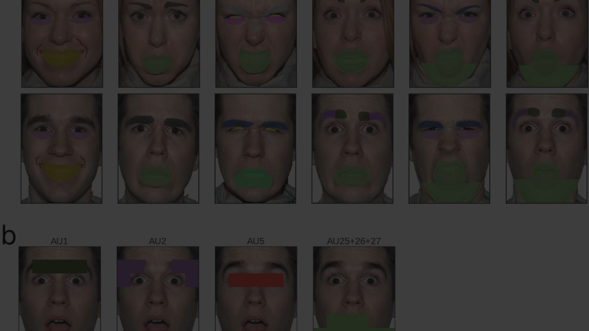
Challenges in Facial Expression Recognition
Diversity
1
Accounting for individual, cultural, and contextual differences in the way people express emotions.
2
Occlusion
Handling situations where facial features are partially obscured, such as by glasses, masks, or other objects.
Real-time Processing
3
Developing algorithms that can accurately and quickly analyze expressions in real-time applications.

Slide 8




Recent Advancements in the Field
Deep Learning
Multimodal Fusion
Edge Computing
Transfer Learning
Leveraging powerful neural network architectures to achieve state-of-the-art performance in facial expression recognition.
Deploying facial expression recognition models on edge devices, enabling real-time, privacy-preserving analysis.
Combining facial analysis with other data sources, such as speech and body language, to improve overall accuracy.
Adapting pre-trained models to new domains and datasets, reducing the need for large-scale training data.

Slide 9



Ethical Considerations in Face Expression Recognition
Privacy
Bias
Transparency
Ensuring the responsible and secure use of facial expression data, protecting individual privacy and consent.
Mitigating algorithmic biases that could lead to unfair or discriminatory outcomes.
Promoting transparency and explainability in the development and deployment of facial expression recognition systems.

Slide 10
Conclusion and Future Outlook
Potential Impact
Facial expression recognition has the potential to revolutionize fields ranging from mental health to automotive safety.
Ongoing Challenges
Addressing issues like diversity, occlusion, and real-time processing remains crucial for widespread adoption.
Future Developments
Advancements in areas like multimodal fusion and edge computing will drive further progress in the field.

